Slide 1
Project Implementation Plan (PIP)
National Hydrology Project
N. K. Manglik, Director
River Data Directorate
Central Water Commission

Slide 2
Project Implementation Plan (PIP)
ALLOCATION FOR CWC IN NHP - 275 cr

Slide 3
Activities proposed to be carried by CWC
Flash flood guidance coupled with weather forecast
Inundation modeling including cyclone related floods in delta regions
Basin-wise Extended Hydrologic Prediction model along with DSS (yield forecasting) for medium & long term forecast

Slide 4
Activities proposed to be carried by CWC
Extension of eSWIS
Development of Regional Models for water availability
Development of aquatic life assessment in major rivers of India
Preparation of reference Evapo-transpiration Atlas for country

Slide 5
Activities proposed to be carried by CWC
Physically based mathematical modelling for sediment rate estimation and sediment transport in the river basin
Strengthening of India-WRIS
Water Technology Park/Center of Excellence at Hyderabad
Balance work/Continuation of HDA-SW Activities-Capacity building of State

Slide 6
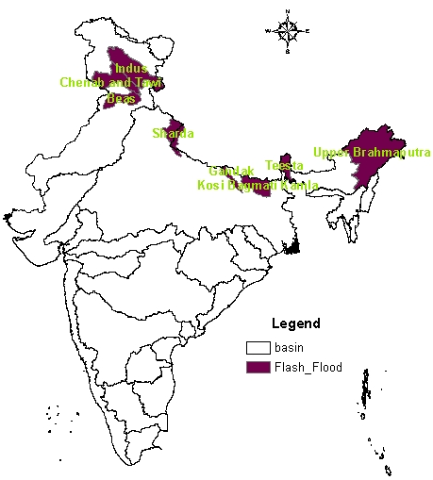
Flash flood guidance coupled with weather forecast
AREA-2.48 Lakh SqKm

Slide 7
Flash flood guidance coupled with weather forecast
SN | Basin/Reaches/ state | SN | Basin/Reaches/state | SN | Basin/Reaches/ state
1 | Bhagirathi | 7 | Nagaland | 13 | Teesta
2 | Alaknanda | 8 | Indus | 14 | Subansiri
3 | Beas | 9 | Arunachal Pradesh | 15 | Lohit
4 | Chenab | 10 | Sharda | 16 | Siang
5 | Jhelam | 11 | Gandak | 17 | Dibang
6 | Tawi | 12 | Kosi

Slide 8
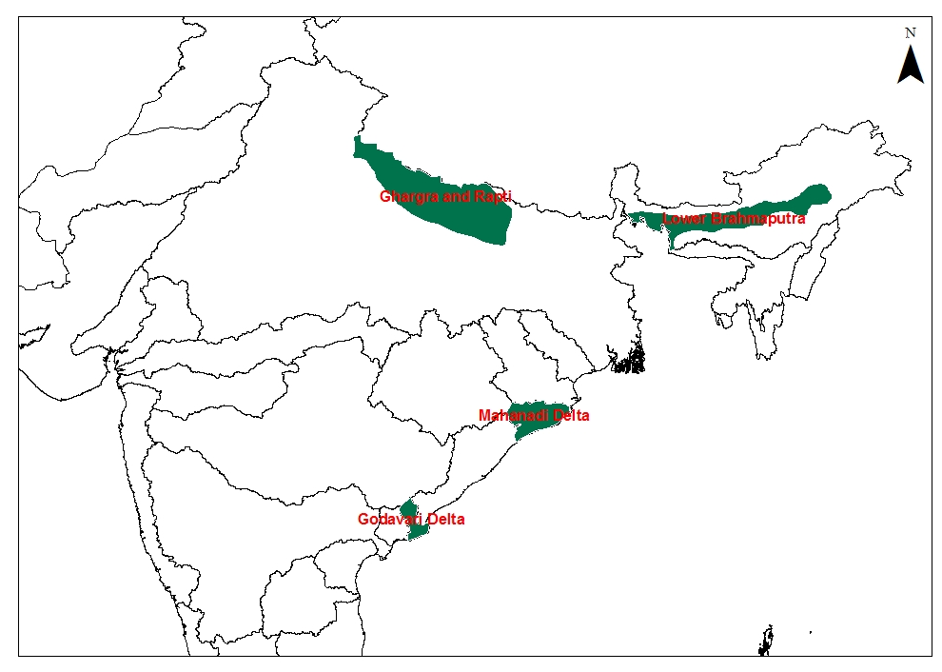
Inundation modeling including cyclone related floods in delta regions
AREA-1.36 Lakh SqKm

Slide 9
Inundation modeling including cyclone related floods in delta regions
SN | Basin/Reaches/state | SN | Basin/Reaches/state
1 | Mahanadi Delta | 4 | Rapti
2 | Godavari Delta | 5 | Ghaghra
3 | Lower Brahmaputra in Assam

Slide 10
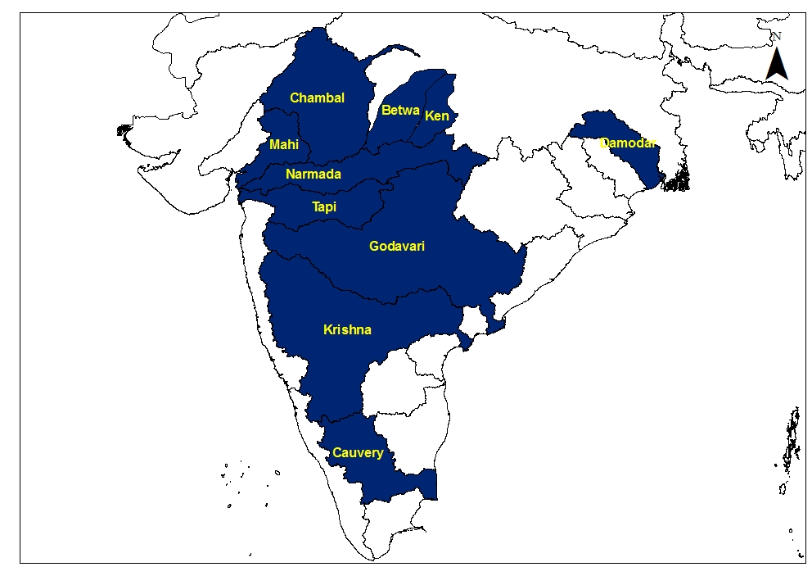
Basin-wise Extended Hydrologic Prediction model
AREA-10.85 Lakh SqKm

Slide 11
Basin-wise Extended Hydrologic Prediction
Objectives
The system will be for 5/10 days lead-time forecast (medium and long term) along with DSS creating an enhanced probabilistic river flow forecasting scheme. At weeks to seasonal time scales, some of the points envisaged to be answered in a basin would be:
Given the current hydrologic condition of a river basin, how much water losses can be anticipated in the water conductor system and what is the likely spatial distribution of the losses?
How much is the likely inflow – Next week? Next month? Next season? What is the range of uncertainty of the likely inflow and how best can this knowledge can be integrated into water allocation and water delivery planning?

Slide 12
Basin-wise Extended Hydrologic Prediction
SN | Basin/Reaches/state | SN | Basin/Reaches/state
1 | Damodar Basin | 5 | Krishna
2 | Cauvery Basin | 6 | Godavari
3 | Chambal Basin | 7 | Ken Betwa
4 | Narmada/Tapi Basin | 8 | Mahi

Slide 13
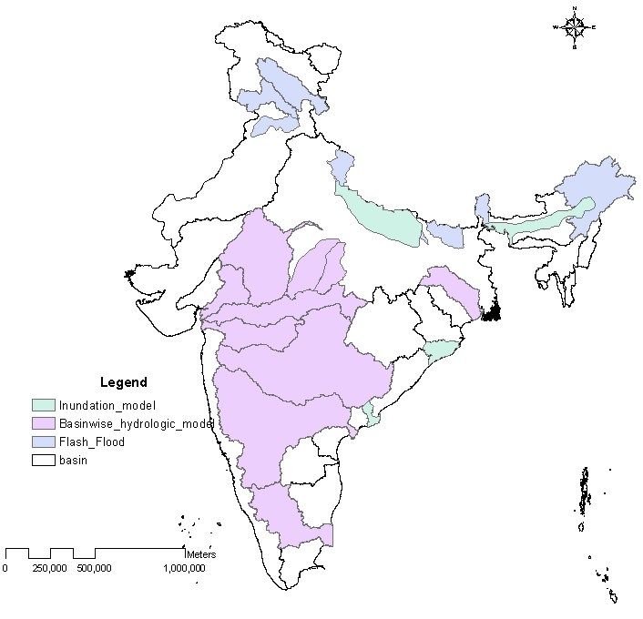
PROPOSED TOTAL AREA COVERED
AREA-14.7 Lakh SqKm

Slide 14
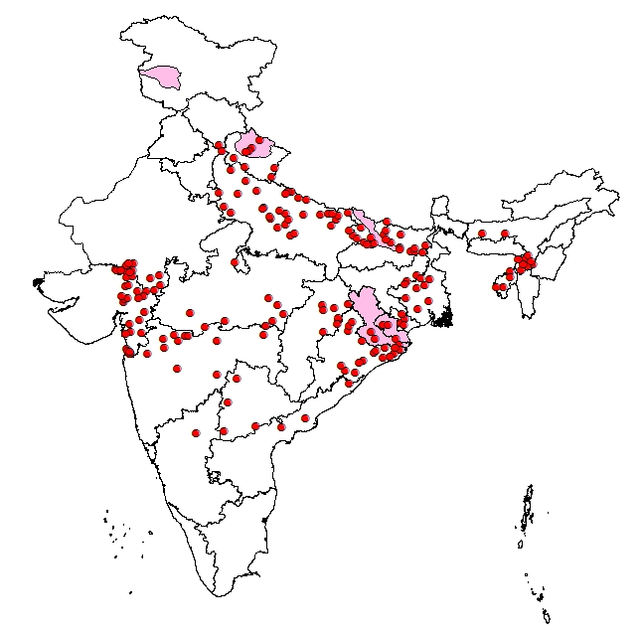
Existing Flood Forecast

Slide 15
Flood Forecasting by CWC
Present network- 176
  Level Forecast -148
  Inflow Forecast- 28
It involves:
  21 divisions
  10 Major River Basins
  72 sub basins
  19 states/UTs

Slide 16
Flood Forecasting Network of CWC
Basin wise FF Stations
Notes:
16

Slide 17
Flood Forecasting Network of CWC
State wise FF Stations
Notes:
17

Slide 18
Proposed Flood Forecasting Sites of CWC During 12th Plan
Total-100
Inflow-62
Level-38

Slide 19
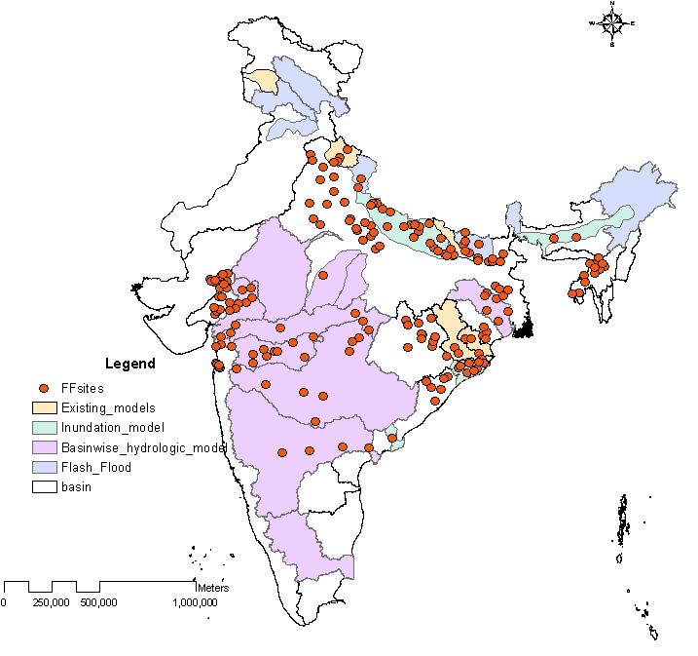
TOTAL AREA AFTER NHP

Slide 20
IWRM plan
10 basins (Five in first phase of 3 year and remaining 5 in second phase).
SN | Basin (Ist Phase) | SN | Basin ( IInd Phase)
1 | Tapi | 6 | Upper Godavari (upto Maharashtra)
2 | Sone | 7 | Upper Mahanadi (upto Hirakud Dam)
2 | Bharthapuzza | 8 | Pennar
4 | Teesta | 9 | Subernrekha
5 | Chambal | 10 | Damodar

Slide 21
Extension of eSWIS
  Development of SMS based Applications for communication of Data.
  Inclusion of Inventories of HO & Met equipment at each site.
  linkage with India-WRIS
  Integration with ERS
  Linkage of product/output of models developed in HP-III

Slide 22
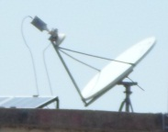
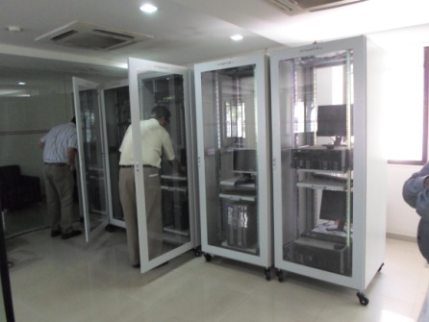
Data flow using INSAT
INSAT
Instantaneous Transmission to State Data Center
BURST \TDMA mode transmission
Satellite Down Link
YAGI
satellite antenna
Sensors
Data Collection Platform (DCP)
ERS at JAIPUR, BURLA
and DELHI
State Data Center
Server with eSWIS software
Other Data
Server with eSWIS software
Cloud server
Cloud server
Backup Server

Slide 23
Data flow using VSAT
Instantaneous Transmission to State Data Center
Sensors
Data Collection Platform (DCP)
State Data Center
Other Data
Server with eSWIS software
Cloud server
Backup Server

Slide 24
Data flow using GSM
Instantaneous Transmission to State Data Center
Sensors
Data Collection Platform (DCP)
State Data Center
Other Data
Server with eSWIS software
Cloud server
Backup Server

Slide 25
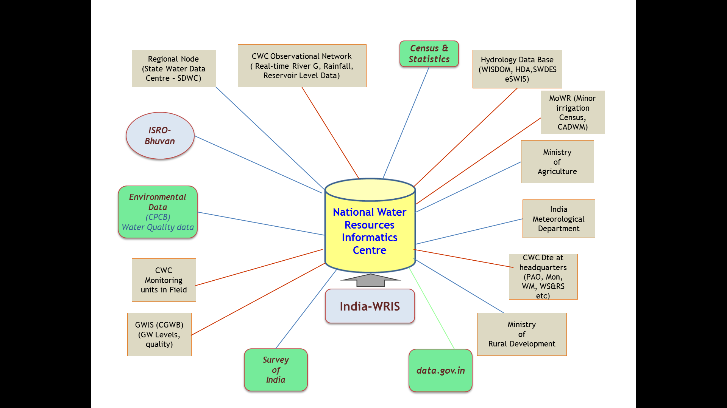
India-WRIS/NWIC
Creation of State Nodes of India-WRIS
Development of Web Services
Support for creation of State-WRIS
Linkages of various models/outputs

Slide 26
Development of Regional Models for water availability
For assessment of Monthly/ Annual yield series for ungauged catchments using basic meteorological & geographical characteristics of the region.
SN | Basin/Regions | SN | Basin/Regions
1 | Ravi and Beas | 6 | Narmada
2 | Brahamputra (Teesta, Subansiri and Debang sub-basins) | 7 | Mahi and Kuch & Saurashtra
3 | Mahanadi | 8 | Subernrekha, Brahimini & Baitarni
4 | Krishna | 9 | Three sub-basin of West flowing rivers
5 | Kaveri, Pennar, Palar & other East flowing Rivers | 10 | A&N Islands and Lakshadweep

Slide 27
Development of Regional Models for water availability
Scope of work:
Establishment of Distributed hydrological model for the basin after calibration and validation
  Identify the dependent parameters for assessing yield series Climate parameters-monthly precipitation, monthly temperature, mean annual rainfall/snowfall etc
  Land use parameters- percent cropped area, forest area etc
  Basin characteristics- watershed area, relief etc
Derive regression equations for assessing yield on monthly basis and monsoon period
Integrate the regression models with HDA-SW or other GUI platform
Prepare report including user manual and examples

Slide 28
Development of aquatic life assessment in major rivers of India
  Mapping of aquatic life of major rivers in the country
  Assessment of habitat requirement i.e. depth, velocity top width,
  Temperature, water quality etc for survival of aquatic life.
SN | Basin/Regions | SN | Basin/Regions
1 | Satluj | 4 | Godavari
2 | Narmada | 5 | West flowing rivers
3 | Brahmaputra

Slide 29
Physically based mathematical modelling for sediment rate estimation and sediment transport in the river basin
SN | Basin/Regions | SN | Basin/Regions
1 | Ramganga Basin | 4 | Three sub-basin of West flowing rivers Kuttiadipuzha Peechi Mangalam
2 | Tapi Basin | 5 | Barak Basin
3 | Mahanadi

Slide 30
Physically based mathematical modelling for sediment rate estimation and sediment transport in the river basin
It aims at assessment of sediment generation from watershed/sub-basin and its transport to desired location. The scope of work includes:
Establishment of Distributed hydrological and sediment model for assessing the sediment generation from various parts of watersheds /sub-basin and sediment transport
Indentifying the critical areas contributing to the sediment generation
Prepare broad sediment management plan

Slide 31
Development and preparation of Evaporation Atlases
Evapo-transpiration is a major component of Water Balance and approximately 50-60 % of the overall precipitation gets lost as ET.
Proposed to capture both Actual & Potential Evapo-transpirations through various mathematical models & prepare ET Atlas for India for a 0.5ºx0.5º or finer resolution.
Scope of the Work would include:
  Identification of appropriate methodology for estimating Potential Evapo-Transpiration based on data availability including use of remote sensing data.
  Establishment of parametric evapo-transpiration model based on the dominating variables in the region for estimating ET
  Validation of model based on observed data available for AET (measured values from Lysimeter & Field Plots)
  Estimation of ET for the country at appropriate temporal ( say fortnightly) and spatial resolution and prepare ET Atlas for the country.

Slide 32
Hydro-meteorological Data Dissemination Policy, 2013
Region-I: Indus basin & other rivers and their tributaries
discharging into Pakistan;
Region-II: Ganga-Brahmaputra-Meghna basin & other rivers and
their tributaries discharging into Bangladesh/Myanmar;
Region-III: Remaining other rivers and their tributaries.
The data of Region-I and II are classified, whereas the data of Region-III is unclassified.
Notes:
32

Slide 33
Hydro-meteorological Data Dissemination Policy, 2013
Reservoir water level, live storage position, water quality, groundwater and meteorological data for all regions are unclassified.
All metadata including yearly average data and historical important data (such as Highest Flood Level, yearly flood peak, etc.) are also unclassified.
sharing of unclassified data on real time basis can be done.
For classified data:
  Historical Data can be provided on case to case basis as per procedure.
  Sharing of Real time data is the policy issues and has to be decided accordingly.
Notes:
33

Slide 34
INVOLVEMENT OF STATES
Flood Forecasting Models for each basin would be developed in the Central Water Commission through consultancy.
  CWC will share the flood data and model output with States.
The involvement of State Government is required for effective flood management and effective implementation of the project.
  Sharing of Hydro-meteorological, topographical and utilization data available with states.
Notes:
34

Slide 35
INVOLVEMENT OF STATES
Involvement of states officials during development of the model
At the end of each major milestone, training/workshop will be conducted to explain the status of the project, activities carried out in detail and sharing the experience faced during that period.
Final model and inundation map libraries will be shared with the state agencies
  Operational training on the model running and result dissemination will be provided to states officials.
  During the Maintenance Phase Workshop/Conferences will be conducted to discuss the challenges faced and success stories in the particular years.
Notes:
35

Slide 36
Thank you

